Slide 1
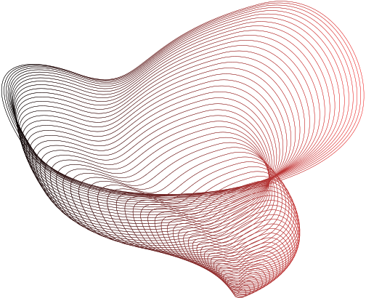


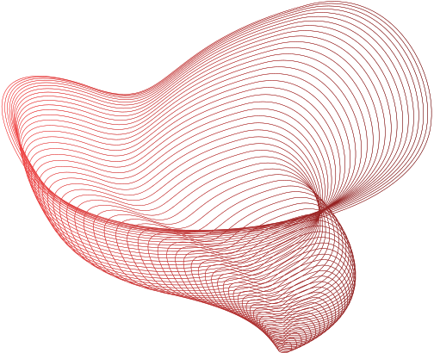
23-12-2023
DATA SCIENCE WORKSHOP
Om Ashish Mishra

Slide 2


Overview
What is Data Science
Data Science
Work of a Data Scientist
How to start Data Science Journey
Understanding Data
Data Collection and Cleaning Techniques
Data Exploration Technique
Feature Engineering
Data Pre-processing
ML Models

Slide 3
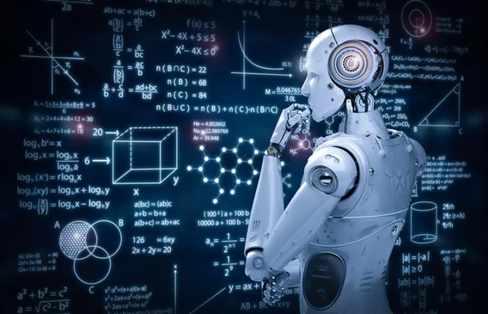


Machine Learning
Artificial Intelligence
Chat GPT

Slide 4
Machine Learning
Data Science
Artificial Intelligence
Chat GPT

Slide 5



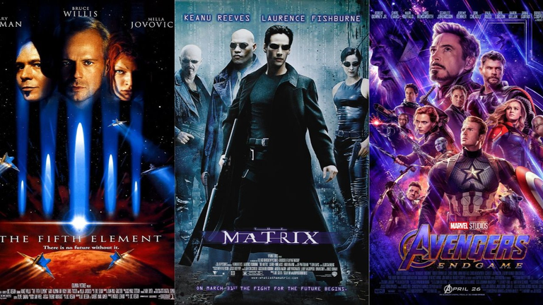


Slide 6




Slide 7




Slide 8

Statistics
Maths
Coding
Data Science
Data
Patterns

Slide 9

Types of Data Science Jobs
Data Scientist
Data Analyst
Data Engineer
Data Architect
Data Storyteller
Machine Learning Scientist
Machine Learning Engineer
Business Intelligence Developer
Database Administrator
Technology Specialized Roles

Slide 10
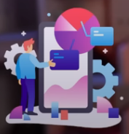



Work of Data Scientist
Collect
Analysis
Process
Insights

Slide 11
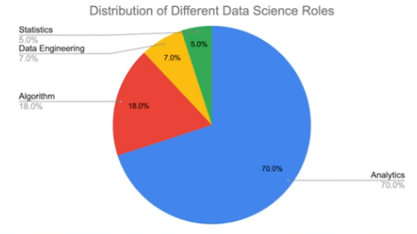
How to start a Data Science Journey
Programming Language - Python/R and learn Numpy and Pandas
Maths - Statistics, Calculas, Linear Algebra, Probability

Slide 12
How to start a Data Science Journey
Programming Language - Python/R and learn Numpy and Pandas
Maths - Statistics, Calculas, Linear Algebra, Probability
Data Visualization - Python, Excel, Power BI, Tablebua,
ML - Supervised, Unsupervised, Reinforcement
Data - Databases, SQL, BigQuery
Notes:
Then make Projects
This can be highlighted in the resume as a proof!
Github - Projects to showcase!
Business analyses for company growth
data - big data
algo - deep learning
business - tools

Slide 13
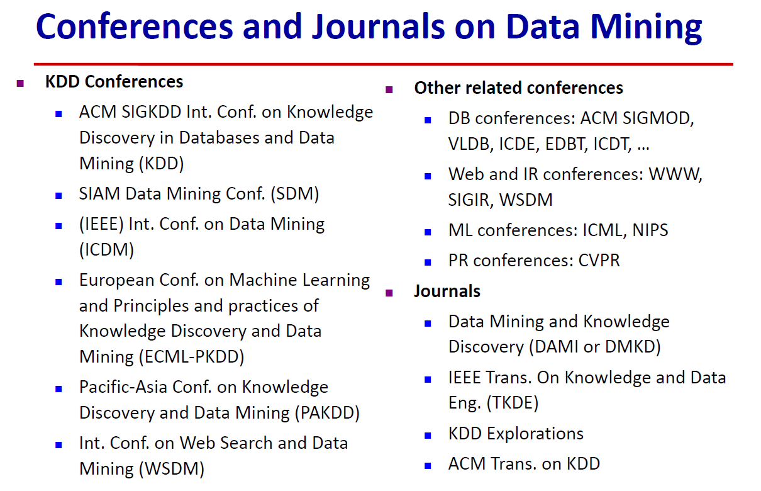

Slide 14





Om Ashish Mishra
https://www.omashish.com
https://twitter.com/ommishra100
https://www.linkedin.com/in/om-ashish-mishra/
https://medium.com/@OmAshishMishra

